Slide 1
Facial Expressions of Android Robots

Slide 2
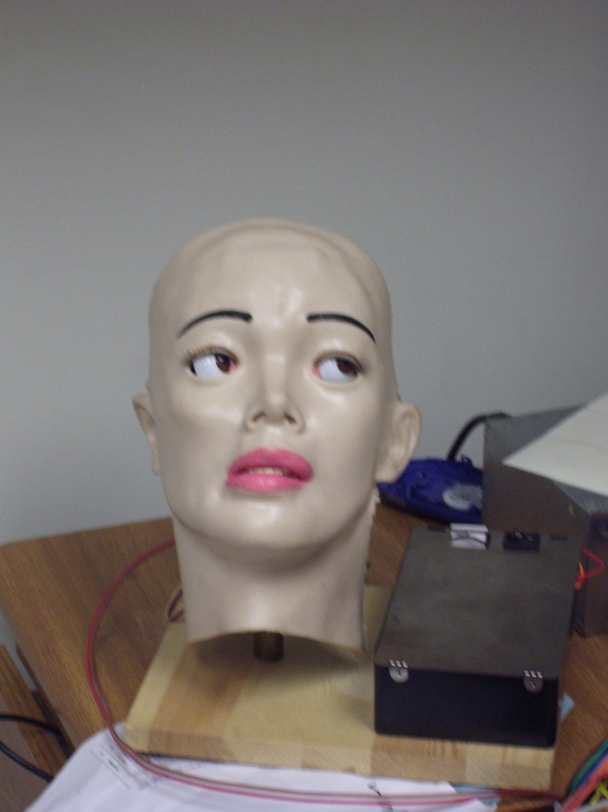
Maria Curie-Sklodowska

Slide 5
Hello, Professor Einstein

Slide 6
It is sunny today

Slide 7
Bad Cat, Bad Cat!
To Schrödinger cat:

Slide 10
Professor Bohr?
Who says this?

Slide 11
Or Sir Issac?

Slide 12
I am so tired

Slide 14
To clean the lab again

Slide 15
Oh, no!

Slide 16
Hair, make-up and hat make a woman!

Slide 17
surprise

Slide 18
happiness

Slide 19
love

Slide 20
Einstein, Oh!

Slide 22
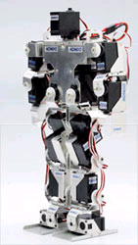
KHR-1
iSOBOT
Lynxmotion Systems

Slide 23
Conclusions
Bottsy and Derpy robots are capable of producing a variety of drawing image styles according to the programmed chromosome and probabilistic state machines.
Image generation in artistic robots is defined by the mechanical design, but is easily extensible to other types of robots (bipeds, faces, mobile).

Slide 24
Conclusions (cont)
The Elo Rating proved to be suitable to create a fitness function for various robot motion projects
The system produces interesting images and facial gestures
IGA is an excellent starting point for future work on applying more objective criteria to evaluate large sets of art objects.
Our plan is to combine it with probabilistic state machine robot behavior generator/verifier [Bhutada – ISMVL 2013] and incorporate into Portland Cyber Theatre project .

Slide 25
Conclusions (cont)
Good for class projects
New type of CAD – designing robot theatre
All our robots are Japanese – may be this research can help to build better software editors for them.

Slide 26
Future Research
More rigorous comparisons between various GA strategies.
Comparison with other ranking algorithms in IGA.
Applications of these fitness functions to Genetic Programming, Ashenhurst-Curtis decomposition and Particle Swarm Algorithms (no such work was done before)
It is also an interesting research problem in itself, as it is related to Google Page Rating and similar problems.

Slide 27
Now show videos
Robot interaction (different)
Greetings
Conflict
Dance
Facial gestures (similar)

